Slide 1


Collecting and Preparing Patient Care Information in Today’s EMS World
October 27, 2008
Aberdeen Fire Department
Presented by……..
Chuck Humphrey, B.A., EMT
Business Development Manager
Enhanced Management Services

Slide 2
Tonight’s Focus……..
What’s a PCR-Patient Care Report
Field Collection
The extra necessaries

Slide 3
Focus (continued)
Signature Requirements
Important Definitions
Read it, check it, print it

Slide 4

What’s a PCR-Patient Care Report
A Legal Document
A Means for Reimbursement
A Life-Saving Tool

Slide 5
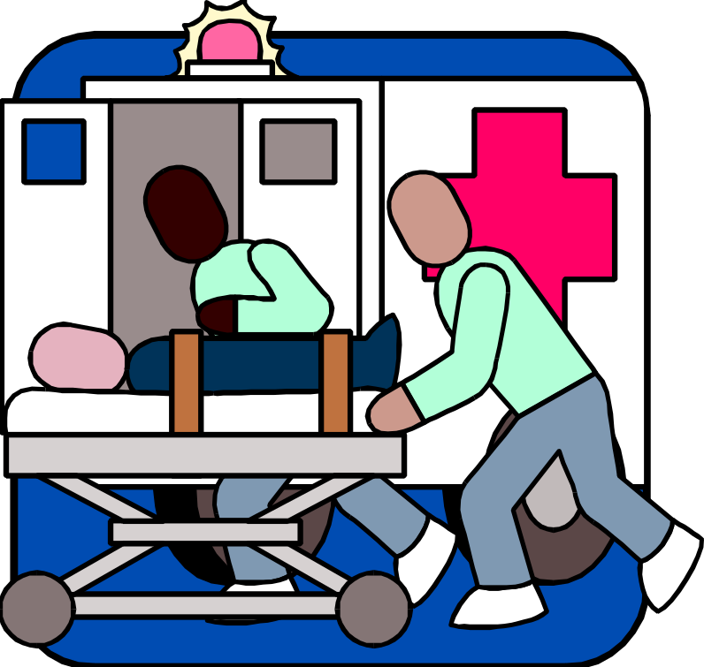
Field Collection
Demographics

Slide 6
Importance of the cover page
Identifying the correct level of service
ALS 2 Defined
SS # and DOB - vital information not obtained on the run sheet
Mileage documentation for billing and for CYA
Origin and Destination Information
HIPAA NPP Presentation Documentation

Slide 7
What’s in a name?
How do you s-p-e-l-l your name?
Name must be EXACTLY as on Medicare/SS Card- (Avoid the dreaded CO140 Denial)
Is it mom’s last name or dad’s?…..minor children require special questioning
Collecting Power of Attorney, Guardian or Legal Representative Information
Let’s make sure we get it all

Slide 8

Addresses
Dispatch vs. Mailing Address- “What is your mailing address?”
C-O-R-R-E-C-T S-P-E-L-L-I-N-G
RR’s, PO Boxes, HCR’s, Apts, Ste
Minors again- “Where/who do you live?”
Zip Codes!!!!

Slide 9



102938956720983740987120345789Numbers102398709870923848910273686102934
(570) 867-5309- Telephone
999-99-9999- Social Security
Date of Birth

Slide 10
Tonight’s Quiz- “Are you a whacker”
1. Sleep at the station always
2. Wears multiple pagers for multiple stations
3. POV is a tactical command vehicle
4. Wears pants too short
5. Talks more on the radio than a DJ
6. Knows every station’s tones by heart
7. 50 Million Gigawatt Blue Light
8. Entire Wardrobe is station gear to be continued

Slide 11

Insurances…...
E/R Face Sheet/Printout works…..but is there more information out there?
Many people have more than one- recipient #’s & group #’s
Medicare xxx-xx-xxxx-A / Medicaid 11 digits
Signatures are VERY important
Minors x3-Who carries the coverage for the child?

Slide 12

Insurances (cont)
Motor Vehicle Accidents….
  Fire/Rescue can help and so can P.D.
  Driver of each car is responsible party
  Tractor Trailers- get name on side of tractor
  Policy numbers and/or Claim number

Slide 13

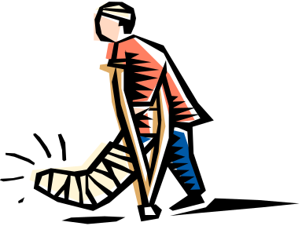
Insurance again….
Worker’s Compensation
  Was it work related?
  Name and Address of Employer
  Name of Worker’s Comp carrier
  Name and phone number of contact

Slide 14
Signatures-New Rules in 2008!
Effective January 1, 2008, new Medicare rules apply when obtaining signatures.
P.U.T.S. no longer acceptable to bill!
Sufficient attempts to obtain a signature no longer acceptable!
Assignment of benefits replaced by verification that service was provided.

Slide 15
Emergencies- Who Can Sign?
Patient
If Patient is Physically or Mentally Incapable…
  Authorized Representative
  Ambulance Crew Member and…
    Receiving Facility Representative or…
    Obtain Secondary Documentation

Slide 16
Patient Signature-Section I
The easiest way to not worry about the new signature rule is to obtain the patient’s signature!!
If patient signs with an “X” or a mark, it is recommended that someone witness when the patient makes the mark on the form.

Slide 17
Authorized Rep-Section II
Docment reason patient is physically or mentally incapable of signing.
Authorized Reps Include only the following...
  Legal Guardian
  Health Care Power of Attorney
  Relative who receives gov’t benefits for patient
  Relative or other person who arranges treatment or handles the patient’s affairs
  Representative of agency or institution that furnished care, services or assistance to the patient in the past

Slide 18
Ambulance Crew/Facility Rep-Section III
Document reason patient incapable of signing, name and location of receiving facility and time of arrival at receiving facility
Crew member signs and obtains…
  Receiving Facility Representative Signature
  Secondary Documentation – most likely facility face sheet/admissions record

Slide 19
The quiz continues>>>
9. Sleeps with scanner on all night, every night
10. Has responded in pajamas and slippers at night
11. Overdue inspection sticker covered by Maltese cross
12. Washes ambulances every weekend
13. Watches TV at station rather than home
14. Watches BackDraft weekly
15. Video tapes all calls

Slide 20




Origins and Destinations
Residences
Emergency Scenes
Facilities
Landing Zones

Slide 21

Pre-Narratives
Take Good Notes!!!
Think beyond EMAIS

Slide 22
THE NARRATIVE
Dispatch Information
Arrival Notes
Chief Complaints
Signs and Symptoms
Observations
Assessment
Treatment
Chronology
Outside Assistance
Transport Incidents
Turning over Patient Care
The Numbers

Slide 23
Do not use alone!
Fainting/Syncope
Non-Ambulatory
Emphysema
Invalid/Homebound; shut in
Weakness
Degenerative Joint Disease (osteoarthritis)
Parkinsons Disease
Alzheimer’s Disease

Slide 24
Nailing Medical Necessity to the Wall!
Complete Narrative
Why Was Transportation By Any Other Means Contraindicated For This Patient, TODAY??? Must Establish Medical Necessity!!!
Examples…Respiratory Distress and Abdominal Distress- Condition Coding Guidelines

Slide 25
EMERGENCY vs Non-Emergency
Emergency Response, BLS or ALS 1, to a 9-1-1 call or the equivalent in areas without 9-1-1
Immediate Response- Begins as quickly as possible to take steps to respond to the call
Dispatch and response must be documented- very important!!
Payment made based on readiness to respond- chance calls not defined as emergencies

Slide 26
ALS 1 Emergency Defined
EMT-I or Paramedic as defined by state and local law
Assessment OR provision of ALS Intervention
Assessment by ALS crew and for trips where only an ALS crew is qualified to perform assessment
Must be emergency response
Does not have to require ALS intervention- defined as a procedure beyond scope of EMT-Basic or as defined by state and local law

Slide 27
ALS 2
3 Medications OR One of the Listed Procedures
Manual defibrillation, Cardioversion, Endotrachael Intubation, Central Venous Line, Cardiac Pacing, Chest Decompression, Surgical Airway, Intraosseous Line
3 Medications can be same drug but must be administered by IV push/bolus or continuous infusion (not included- aspirin, oxygen, crystalloid, hypotonic, isotonic, hypertonic solutions (e.g. dextrose, saline, ringer’s lactate)
Must be critically ill or injured patient

Slide 28
Specialty Care Transport
Interfacility
Critically Injured or Ill Patient
Beyond Scope of EMT-Paramedic- RN, RT, ETC. can be employees of hospital or ambulance
Ongoing care required by - nursing, emergency medicine, respiratory care, cardiovascular care, EMT-P w/additional training
Documentation must include the person making the upgrade and what they are monitoring, etc.

Slide 29

Bed Bound or Bed Confined
ALL THREE CRITERIA MUST BE MET
  Unable to get up from bed without assistance
  Unable to Ambulate
  Unable to sit in a chair
      INCLUDING a wheelchair!!!
Note- Not synonymous with “bed rest” or “non-ambulatory”

Slide 30
Compiling/Writing-Final Touches
Write a story and write it right away!!
Go Beyond EMAIS
Dates of Service
Compiling the Necessaries
Abbreviations
Putting it all together in one nice neat package

Slide 31



The Finishing Touches…..
READ IT!
CHECK IT!
PRINT IT!

Slide 32
Who’s The Whacker?

Slide 33
Thank You!
Chuck Humphrey
Enhanced Management Services, Inc.
(800) 369-7544
Chumphrey@enhancedms.com

